Slide 1
SECI's Rs 5.25 thermal-mimic auction:
designs, costs, and penalties
Which solar + battery designs could serve the 1000 MW FDRE-RTC-V profile, at what cost, and with what penalties
Umed Paliwal · Amol Phadke · Nikit Abhyankar
umed@berkeley.edu · University of California, Berkeley · August 2026

Slide 2
THE TENDER AND THE RESULT
AUGUST 2026
SECI's 1000 MW thermal-mimic tender cleared at Rs 5.25-5.26/kWh
SECI-FDRE-RTC-V: 1000 MW, ISTS-connected, RfS March 10 2026, e-reverse auction concluded August 7 2026
WHAT THE PPA DEMANDS, PER 15-MINUTE BLOCK
THE RESULT: 7 WINNERS AT RS 5.25-5.26
Window | Definition | Required DFR
Peak hours (6 hrs/day) | buyer-chosen day-ahead, 18:00 to 10:00 window | >= 90%
Solar hours (Grid-India) | roughly 08:00-18:00 | 50% floor, 60% cap
Remaining hours | all other non-solar hours | >= 70%
Winner | Capacity | Rs/kWh
Kengeri Prime Solar (Rays Power) | 180 MW | 5.25
Resolven Four Energy | 150 MW | 5.25
Hexa Climate Solutions | 150 MW | 5.26
Hero Solar Energy (Hero Future) | 120 MW | 5.25
EMIF II Holding V II Cooperatief | 100 MW | 5.25
Purvah Green Power (RPSG) | 70 MW | 5.25
Juniper Green Energy | 230-300 MW | 5.26
●
Penalty: 1.5x the PPA tariff on every block's shortfall below the floor, reconciled monthly. No monsoon relaxation survived the amendments.
●
Escape valve: 5% market energy. Clause 8.1.j lets the developer buy up to 5% of the annual required energy, about 292 GWh per GW-year, from the green market to fill shortfalls.
●
Excess solar-hour power above the 60% cap earns only 50% of tariff (buyer holds first right of refusal).
16 bidders participated. Profile rewritten mid-tender: Amendment-03 (June 25) turned flat RTC into the three-tier thermal mimic above.
MNRE Secretary, August 7: “we discovered a rate of Rs 5.25 per unit for RE RTC”, cheaper than recent thermal PPAs at Rs 5.4-6.3 per unit.
Sources: SECI RfS SECI/C&P/IPP/13/0020/25-26 (Mar 10, 2026), Amendments 01 (Apr 2), 02 (Apr 27), 03 (Jun 25, 2026), Clarifications-01 (Apr 27, 2026), seci.co.in tender SECI000240; results per SaurEnergy and MNRE Secretary statement, Aug 7, 2026 (Juniper reported at 300 MW quoted; 230 MW consistent with the 1000 MW cap and bucket-filling); thermal PPA range per Powerline, Mar 2026.
SECI FDRE-RTC-V analysis · solar + storage vs the Rs 5.25 result · 1 of 12
Paliwal · Phadke · Abhyankar · umed@berkeley.edu

Slide 3
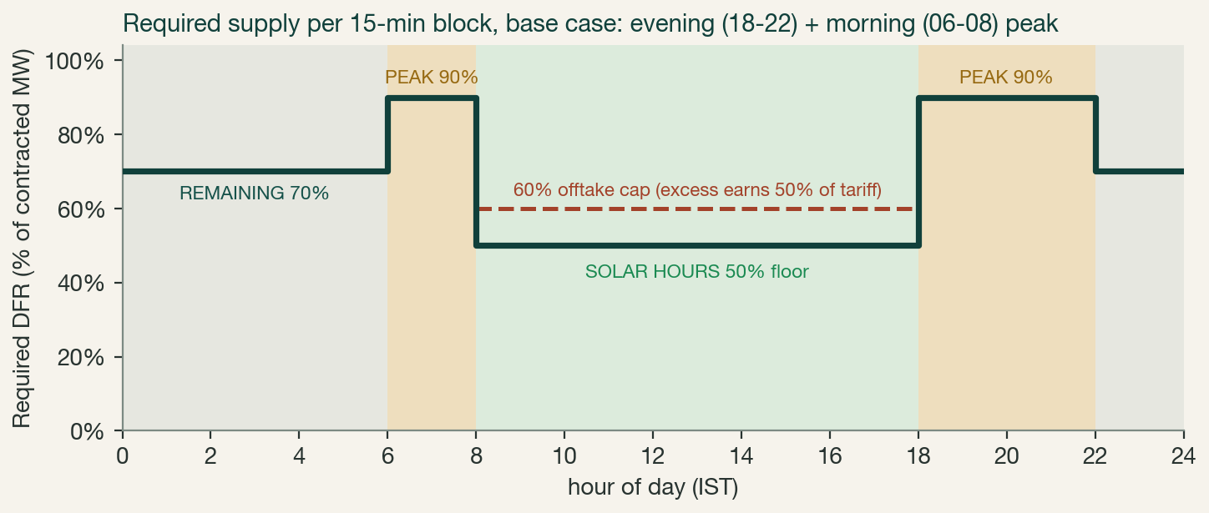
STEP 1: UNDERSTAND THE REQUIRED PROFILE
AUGUST 2026
The required profile: 90% in night peaks, 50-60% in solar hours
THE DAILY ENERGY MATH, PER GW
Peak, 6 h x 90%
5.4 GWh
Solar hrs, 10 h x 50%
5.0 GWh
Remaining, 8 h x 70%
5.6 GWh
Total per day
16.0 GWh
Effective CUF
67%
Overnight, battery-served
~11 GWh
WHAT THINGS COST (BASE CASE)
Solar capex
Rs 3.75 cr/MW-AC
Battery capex, nameplate
Rs 8,550/kWh ($90)
Battery cell replacement, yr 15
in capex (PV Rs 870 cr)
The buyer picks the 6 peak hours day-ahead, anywhere from 18:00 to 10:00 the next morning: the design must survive evening, morning, and split peaks.
WACC 10% · 25 yr · O&M 1.5%/yr
Capex per GW, 3.0 GW + 12 GWh
Rs 22,650 cr
Penalty at Rs 5.25 tariff (1.5x)
Rs 7.88/kWh
Market energy: Rs 4.50/kWh, cap
292 GWh/yr
Why this leans on the battery: the profile demands ~11 GWh through non-solar hours, when the plant runs on storage alone. A 3% equipment failure rate derates all generation, charging included; a charged battery covers the loss. With a 1.4 DC-AC ratio, the battery, not the panels, sets the design.
Profile per RfS Clause 8.1.a as amended by Amendment-03 (Jun 25, 2026); peak-hour mechanics per Clause 8.1.c as amended by Amendment-01 (Apr 2, 2026); solar hours per Grid-India GNA state-wise declaration, modeled as 08:00-18:00 IST per the Annexure-C illustration, which prices 17:00-18:00 blocks at DFR 50; 15-minute blocks modeled at hourly resolution.
SECI FDRE-RTC-V analysis · solar + storage vs the Rs 5.25 result · 2 of 12
Paliwal · Phadke · Abhyankar · umed@berkeley.edu

Slide 4
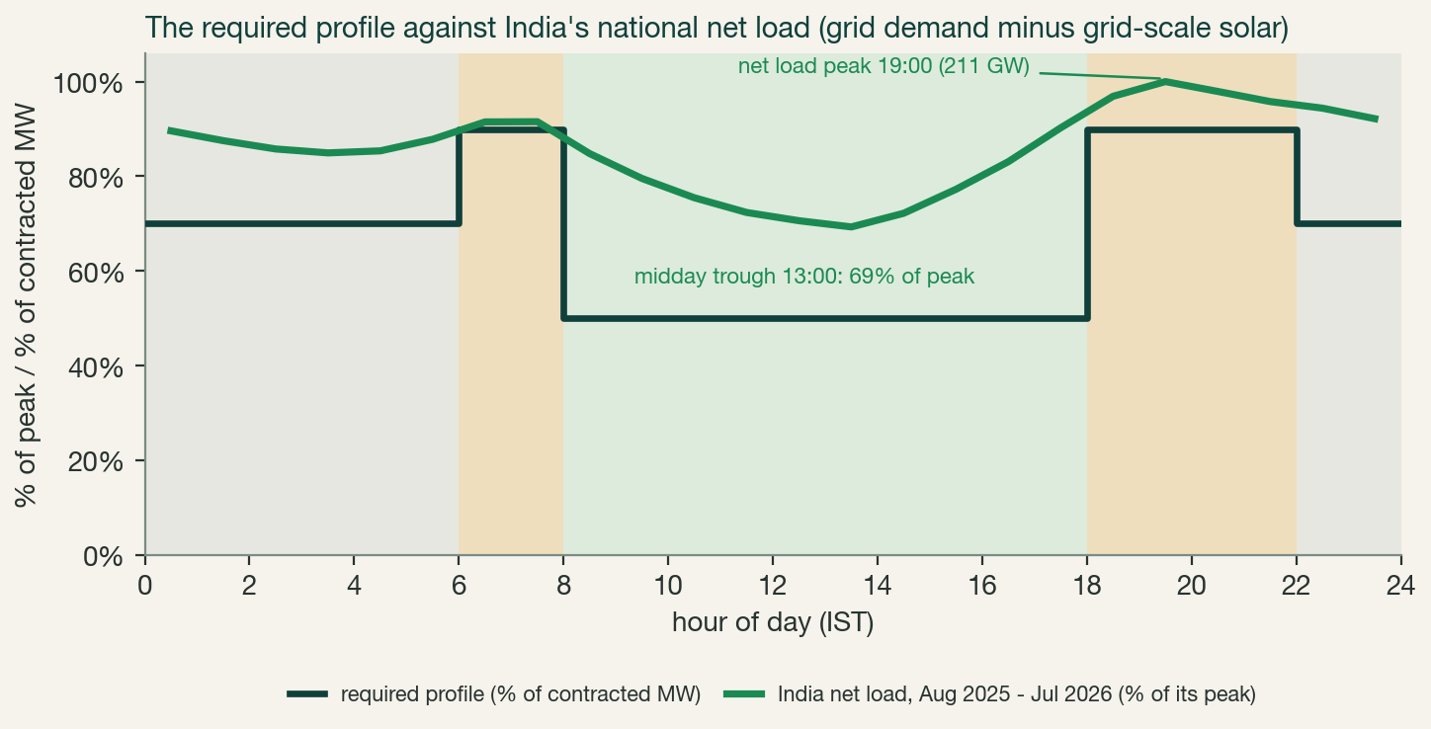
WHY THIS SHAPE: INDIA'S NET LOAD
AUGUST 2026
The profile SECI auctioned is India's net load profile
All-India grid demand minus grid-scale solar, Grid-India 15-minute SCADA aggregated to hourly means, Aug 2025 - Jul 2026
SECI IS PROCURING THE NET LOAD
●
India's peak now comes after sunset: gross demand peaks at 10:00; solar has pushed the residual peak to 19:00 (211 GW). The tender's evening peak block starts exactly there.
●
The 90% evening floor buys the ramp: net load climbs 65 GW in the six hours into the peak, the steepest and scarcest hours on the grid; the tender turns that climb into a firm, penalty-backed product.
●
The 50-60% midday band mirrors the solar flood: midday net load has already fallen to 69% of the evening peak and drops further each year solar grows; the tender caps offtake in exactly those hours.
●
The 70% overnight floor is the one concession: the grid still runs at ~87% of peak overnight, but holding 90% all night from a battery would price the product out of reach.
A thermal mimic is a net-load product. The demand left after cheap midday solar is what India's coal fleet serves today; the tender packages that residual shape into a PPA. Solar + storage is the cheapest machine that fits it.
Sources: Grid Controller of India (NLDC) daily Power Supply Position reports, 15-minute SCADA time series, Aug 1 2025 - Jul 31 2026 (98.0% of blocks), accessed via the Grid-Sentinel open dataset, github.com/HalcyonVector/Grid-Sentinel (CC BY-SA 4.0); demand is grid-served demand met, so rooftop solar and captive appear as suppressed demand; net load = demand minus grid-scale solar; curve normalized to its peak (annual hourly means). Cross-checked against NITI Aayog ICED national load curves (iced.niti.gov.in) and POSOCO daily-report compilations (robbieandrew.github.io/india). Net-load framing and validation: Sanyal and Dev, The Duck and The Camel: Tracing the Net Load on the Indian Power Grid, EAC-PM Working Paper 53/2026, Jul 2026 (eacpm.gov.in); this series reproduces its May-2026 ramp and peak statistics exactly.
SECI FDRE-RTC-V analysis · solar + storage vs the Rs 5.25 result · 3 of 12
Paliwal · Phadke · Abhyankar · umed@berkeley.edu

Slide 5
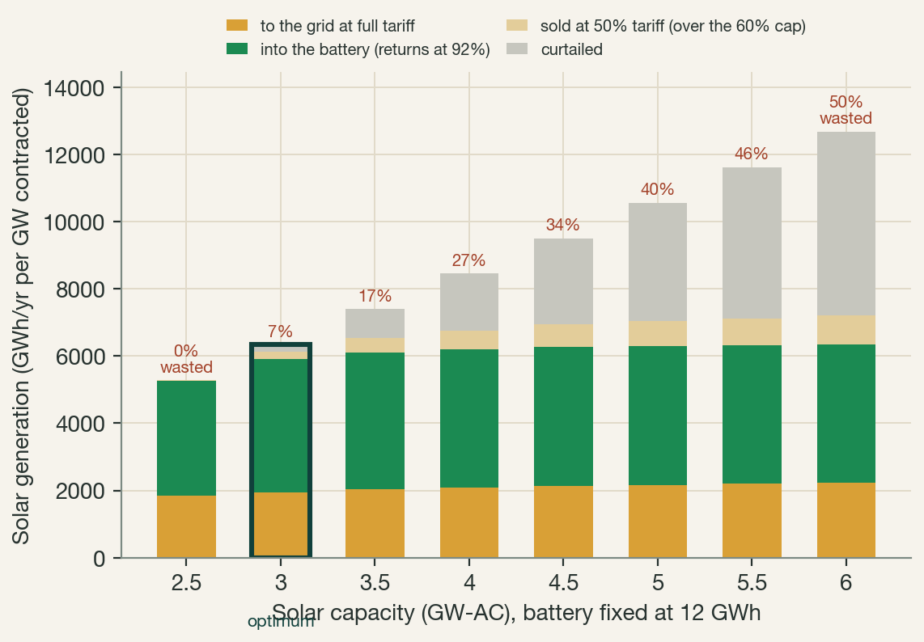
STEP 2: THE DESIGNS AND THEIR COSTS
AUGUST 2026
All costs in: Rs 5.15 lean, or Rs 5.28 with zero penalty, in Rajasthan
Hourly dispatch of 10 weather years against the final tender rules; every cost below includes capex, O&M, replacements, market purchases, and penalties
THE COST ANATOMY OF SIX RAJASTHAN DESIGNS (RS/KWH, PENALTIES INCLUDED)
Design (per GW) | Solar | Battery | Market energy | Penalties | ALL-IN | Penalty, avg / worst year
3.0 GW + 12 GWh OPTIMUM | 2.37 | 2.54 | 0.21 | 0.03 | 5.15 | 0.5% / 3.0%
3.5 GW + 12 GWh ZERO PEN | 2.69 | 2.47 | 0.13 | 0.00 | 5.28 | zero in all 10 yrs
4.0 GW + 12 GWh | 3.02 | 2.43 | 0.08 | 0.00 | 5.53 | zero
3.0 GW + 14 GWh | 2.38 | 2.97 | 0.18 | 0.01 | 5.53 | 0.1% / 1.1%
3.5 GW + 14 GWh | 2.69 | 2.88 | 0.09 | 0.00 | 5.67 | zero
4.0 GW + 14 GWh | 3.03 | 2.84 | 0.05 | 0.00 | 5.92 | zero
Half solar, half battery, everywhere. Battery cost falls slightly with more solar (fewer penalties, fuller charging); the market-energy and penalty components shrink to nothing as solar grows. Rs 5.25 buys either the optimum with modest penalty risk, or 3.5 GW nearly penalty-free at Rs 5.28.
The design walks a ridge: cut solar to 2.5 GW and the worst weather year pays 20% of revenue in penalties; add it beyond 3 GW and the new generation mostly goes unsold: 7% of solar is spilled or curtailed at the optimum, 50% at 6 GW. The full cost grid is on the next slide.
All-in cost = (annualized capex + O&M + market purchases + penalties) ÷ billed energy (incl. spill at 50% tariff)
Costs: solar Rs 3.75 cr/MW-AC; battery Rs 8,550/kWh ($90 at Rs 95/USD); WACC 10%, 25 yr; 3% equipment failure rate on all generation. Penalties: each hour stands in for four identical 15-minute blocks; an hour below its floor draws first on market energy (Rs 4.5/kWh, capped at 292 GWh/yr = 5% of required energy); the residual pays 1.5x tariff, Rs 7.88/kWh, reconciled monthly.
SECI FDRE-RTC-V analysis · solar + storage vs the Rs 5.25 result · 4 of 12
Paliwal · Phadke · Abhyankar · umed@berkeley.edu

Slide 6
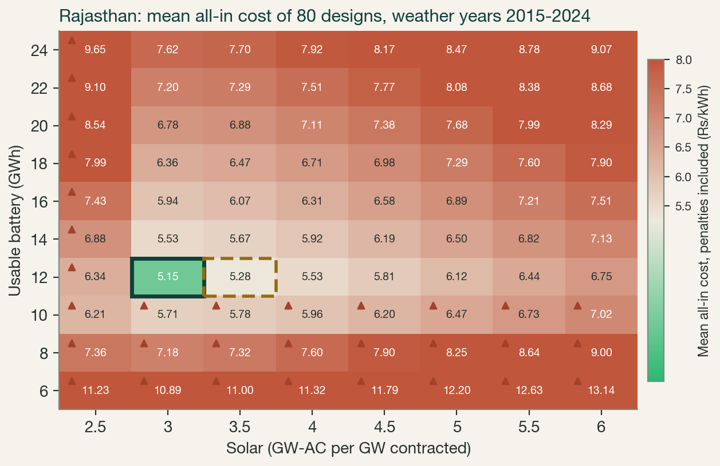
STEP 2B: THE FULL DESIGN SPACE
AUGUST 2026
Every design priced: the auction lands in a one-cell green corner
Mean all-in cost of 80 Rajasthan designs, solar 2.5-6.0 GW-AC x usable battery 6-24 GWh, ten weather years, penalties included
THE AUCTION HAS NO SLACK IN IT
●
One cell of 80 beats the discovered price: 3 GW + 12 GWh at Rs 5.15 (solid box). Rs 5.25 is the frontier itself, not a comfortable bid: the winners are committed to building this exact design, in Rajasthan-class sun, executed at $90/kWh batteries.
●
Mis-sizing is punished asymmetrically: the valley is flat along the battery axis (10-14 GWh sit within ~Rs 0.1) and brutal along solar: half a gigawatt less sends the worst weather year to 20% of revenue in penalties (triangles); half more starts the slide into half-tariff spill. Real design freedom is about one cell wide.
●
Battery size stops mattering at 12 GWh: every column's cheapest cell sits at 10-12 GWh; beyond it capex rises with no penalty relief, because bad weeks are an energy deficit, not a duration problem. The hedge the design buys with money is solar, never more battery.
●
Reading aids: colour pivots at Rs 5.25 (gold line on the scale); dashed box = zero-penalty design (3.5 GW + 12 GWh, Rs 5.28); cells above Rs 8 saturate dark red.
UC Berkeley simulation, Aug 2026: uniform-grid re-run of the same dispatch and cost model as the previous slide (sim/run_heatmap_sweep.py, results/agg_Rajasthan_heatmap.csv, identical to the v4 basis on shared cells); mean of weather years 2015-2024, 3% equipment failure rate, market energy and penalties inside every cell; split peak scenario. Colour scale capped at Rs 8/kWh.
SECI FDRE-RTC-V analysis · solar + storage vs the Rs 5.25 result · 5 of 12
Paliwal · Phadke · Abhyankar · umed@berkeley.edu

Slide 7
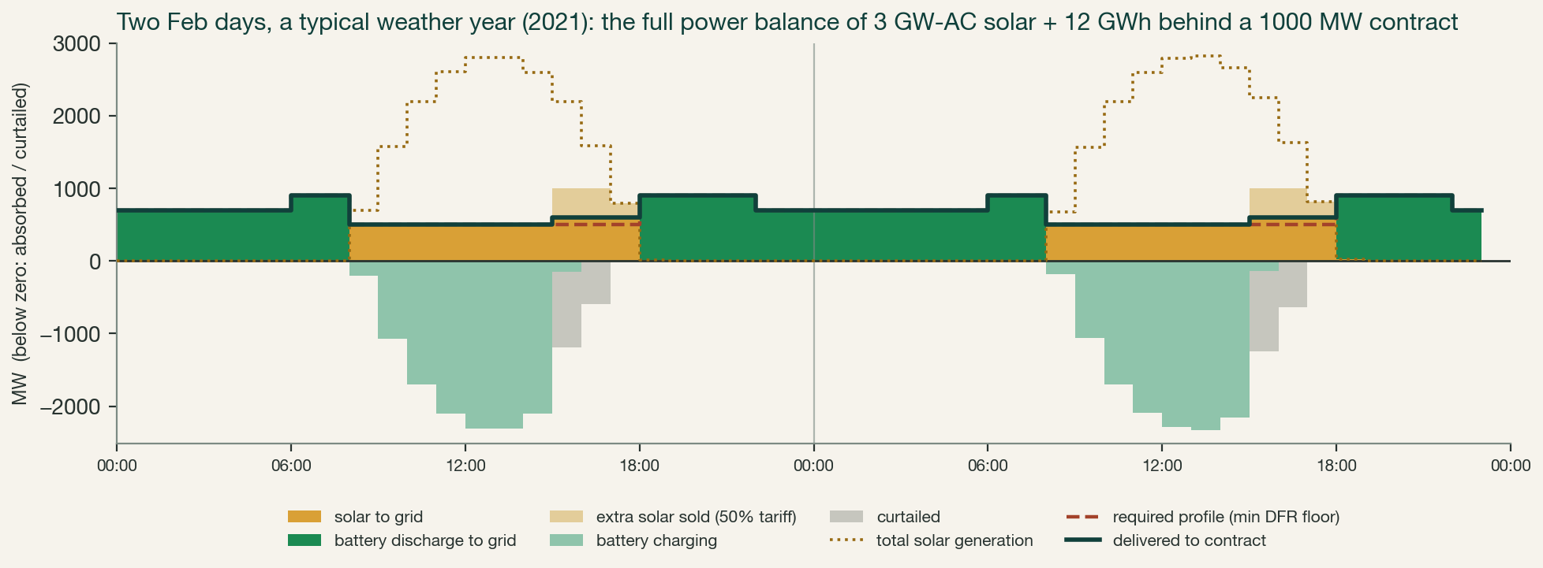
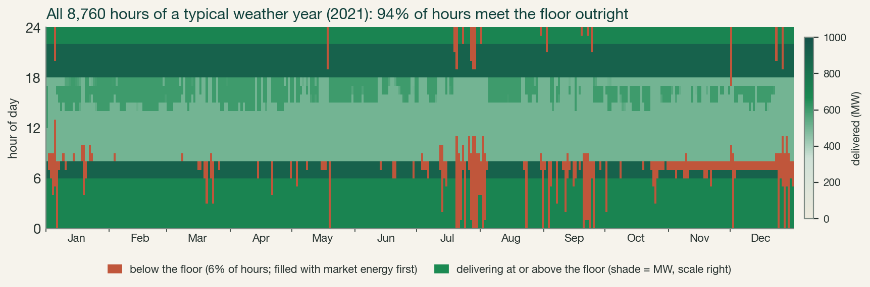
THE PLANT IN OPERATION
AUGUST 2026
How the plant operates: two typical days, and the full year
The optimal Rajasthan design (3.0 GW + 12 GWh): two ordinary days, then all 8,760 hours of a typical weather year (2021)
UC Berkeley simulation. Top: the full power balance over two clean Feb days: above zero, what the grid receives (gold solar, green battery discharge, pale gold extra solar sold at 50% tariff); below zero, where the surplus goes (charging, then curtailment); dotted = total solar generation, 4.2 GW-DC behind a 1000 MW contract. Bottom: every hour of 2021 by delivered MW; 94% of hours clear the floor outright, the red rest draws market energy first.
SECI FDRE-RTC-V analysis · solar + storage vs the Rs 5.25 result · 6 of 12
Paliwal · Phadke · Abhyankar · umed@berkeley.edu

Slide 8
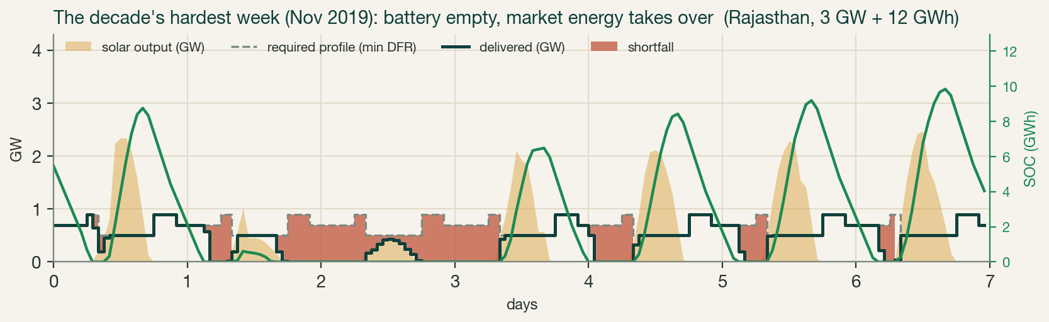
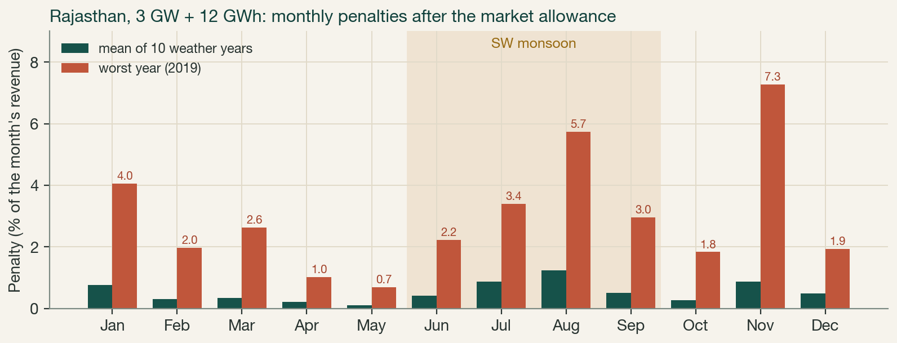
STEP 3: STRESS-TEST THE DESIGN
AUGUST 2026
Shortfalls come from monsoon and winter cloudy spells
Rajasthan, the optimal design (3.0 GW-AC + 12 GWh usable); shortfall is bimodal: monsoon plus early winter
WHAT IT MEANS COMMERCIALLY
●
Worst-year deficit 6.9% of required energy (2019): the 292 GWh market allowance maxes out and 115 GWh still goes to penalty, 3.0% of revenue.
●
In an average year penalties are 0.5% of revenue (Rs 0.03/kWh); the allowance is heavily drawn (283 of 292 GWh on average), so bad seasons go straight to penalty.
●
Storage cannot fix cloudy weeks: they are an energy deficit, not a time-shifting problem. Half a gigawatt more solar, not more battery, removes the residual risk entirely.
UC Berkeley simulation, Aug 2026. Top: the decade's hardest week (Nov 2019). Bottom: monthly penalties as a share of the month's revenue; billing is monthly but sums to the annual total. The allowance itself is ANNUAL by Clause 8.1.j and PPA 4.4.9 ('on annual basis'): spring allowance banks into the monsoon, worth ~Rs 0.13/kWh vs a monthly cap.
SECI FDRE-RTC-V analysis · solar + storage vs the Rs 5.25 result · 7 of 12
Paliwal · Phadke · Abhyankar · umed@berkeley.edu

Slide 9
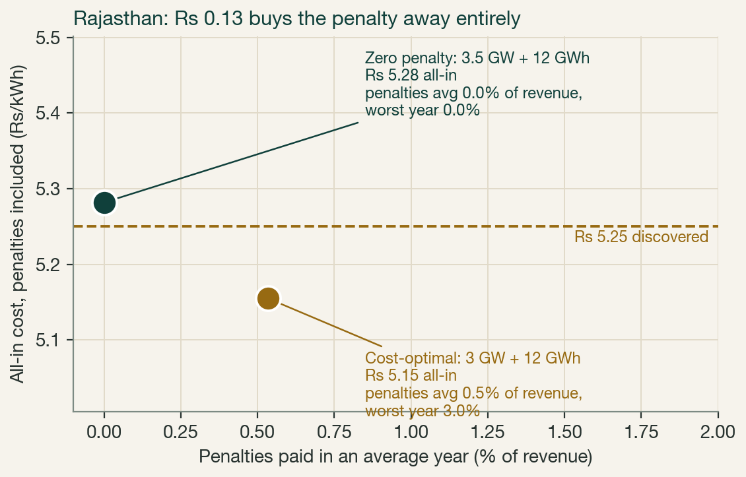
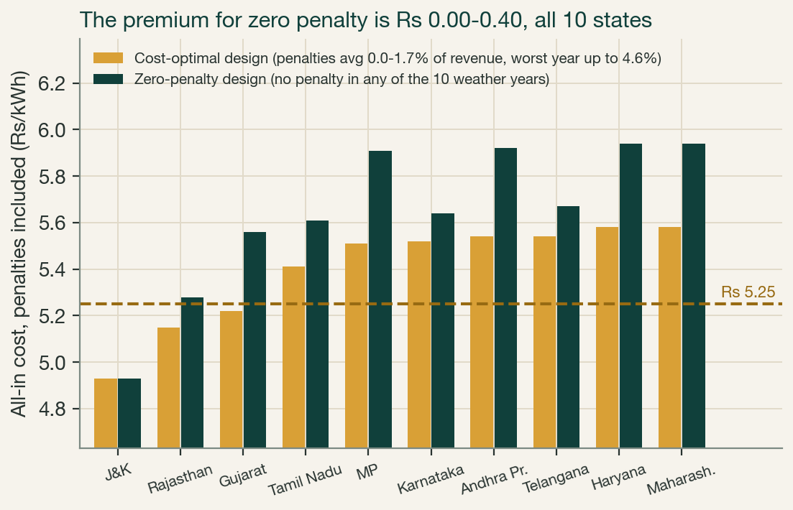
STEP 4: PENALTIES UNDER CONTROL
AUGUST 2026
Zero penalty costs Rs 0.13-0.40 more than the cost-optimum
Penalties are inside every cost shown; averages and worst years are over the ten weather years, with the 3% outage rate in dispatch
Penalties are inside every number. The cost-optimal designs pay 0-1.7% of revenue in an average year (worst year up to 4.6%); half a gigawatt of extra solar makes them zero for Rs 0.00-0.40 more. At $90/kWh batteries, J&K (4.93), Rajasthan (5.15) and Gujarat (5.22) clear Rs 5.25; the Rajasthan penalty-free build costs Rs 5.28, almost exactly the bid.
UC Berkeley simulation, Aug 2026: penalties as simulated (1.5x tariff on shortfall below the floors, after the 292 GWh/yr market allowance = 5% of required energy), 3% equipment failure rate on all generation, weather years 2015-2024. Cost-optimal configs: 3.0-3.5 GW + 12 GWh; zero-penalty configs: 3.0-4.5 GW + 12 GWh. Full table: results/scenario_table_v4.csv.
SECI FDRE-RTC-V analysis · solar + storage vs the Rs 5.25 result · 8 of 12
Paliwal · Phadke · Abhyankar · umed@berkeley.edu

Slide 10
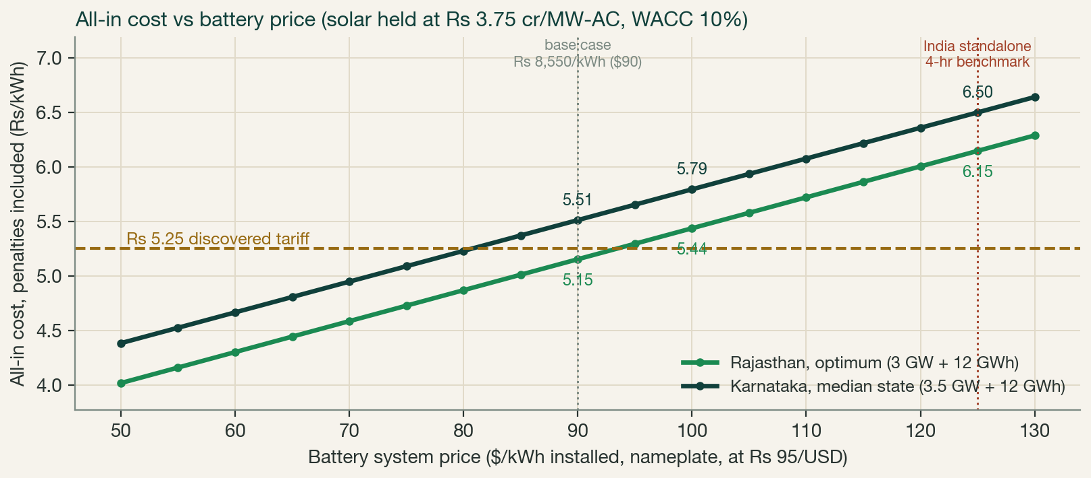
THE COST DRIVER THAT DECIDES EVERYTHING
AUGUST 2026
Rs 5.25 supports $89-93/kWh batteries in Rajasthan, penalties included
All-in cost vs battery system price, at Rs 95/USD, solar held at Rs 3.75 cr/MW-AC
READING THE AUCTION RESULT
●
At our $90/kWh base case three states clear the bid: J&K Rs 4.93, Rajasthan Rs 5.15, Gujarat Rs 5.22; the median state needs Rs 5.52.
●
Break-even battery prices: $93/kWh for the lean Rajasthan build, $89 for its zero-penalty variant, $81 in a median state, $102 in J&K. At BNEF's China turnkey $73, Rajasthan costs Rs 4.67.
●
So Rs 5.25 is a northwest-siting bid at today's battery prices, with margin growing as prices fall toward China's.
●
Every $10/kWh decline cuts ~Rs 0.28: at $60-65 the next auction clears near Rs 4.3-4.6, decisively under thermal PPAs (Rs 5.4-6.3).
UC Berkeley analysis, Aug 2026: all-in cost at each battery price on each config's mean dispatch outcome (cell replacement scales with system price; WACC 10%, 25 yr constant). BNEF 2025 China turnkey price $73/kWh; thermal PPAs Rs 5.4-6.3 (Powerline); SECI FDRE-IV cleared Rs 4.98 (easier profile, Jul 2024).
SECI FDRE-RTC-V analysis · solar + storage vs the Rs 5.25 result · 9 of 12
Paliwal · Phadke · Abhyankar · umed@berkeley.edu

Slide 11
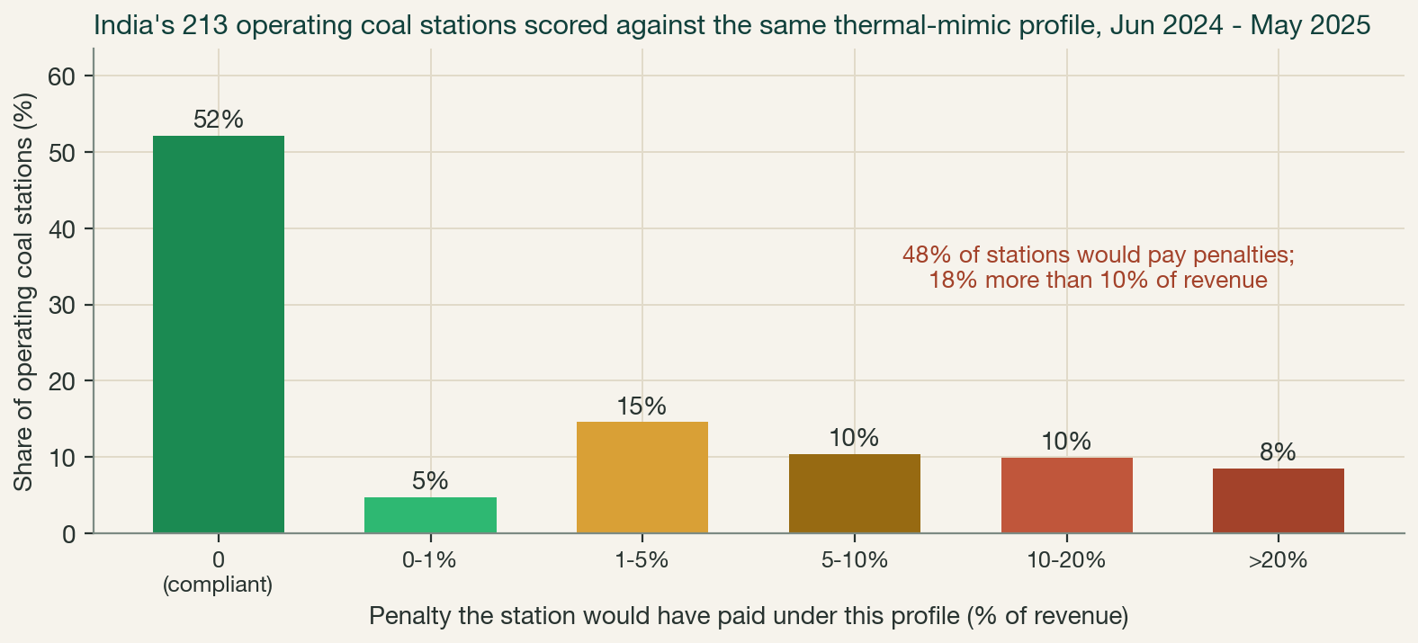
THE THERMAL BENCHMARK
AUGUST 2026
Coal stations scored on the same profile: 48% would pay penalties
Every operating coal station in India scored against this exact profile, using its actual daily outage record (CEA data, June 2024 - May 2025)
HOW EACH STATION IS SCORED
●
From CEA daily outage tables: a station's availability each day = 1 - MW on outage / station capacity, so sister units cover an outaged one. Its shortfall that day = the profile floors that availability cannot meet, summed over 24 hours.
●
Identical rules: the year's shortfall, less the same 292 GWh market allowance, is penalized at 1.5x tariff; planned and forced outages both count. Economic backdown does not: a 60% PLF station still passes if its capacity was available (median station availability is 90%).
●
Of 213 operating stations, 52% would clear penalty-free; 48% would pay, and 18% would lose more than 10% of revenue. Scored unit by unit instead (619 operating units), only 32% clear, and the median unit loses 7.7% of revenue.
●
The punchline: solar + storage (0.5% average, zero for Rs 0.13 more) performs like the BETTER HALF of the coal fleet, at a price below recent thermal PPAs.
UC Berkeley analysis of CEA Daily Generation Report unit outage tables, Jun 1 2024 - May 31 2025 (49,898 unit-day records; 224 stations from 661 units with inferred nameplates, 213 operating at >=50% availability); station availability = 1 - total outage MW / station capacity; contracted = station capacity; only Force Majeure excused, so planned and forced outages both count; caveat: one thermal year vs ten simulated weather years for solar+storage.
SECI FDRE-RTC-V analysis · solar + storage vs the Rs 5.25 result · 10 of 12
Paliwal · Phadke · Abhyankar · umed@berkeley.edu

Slide 12
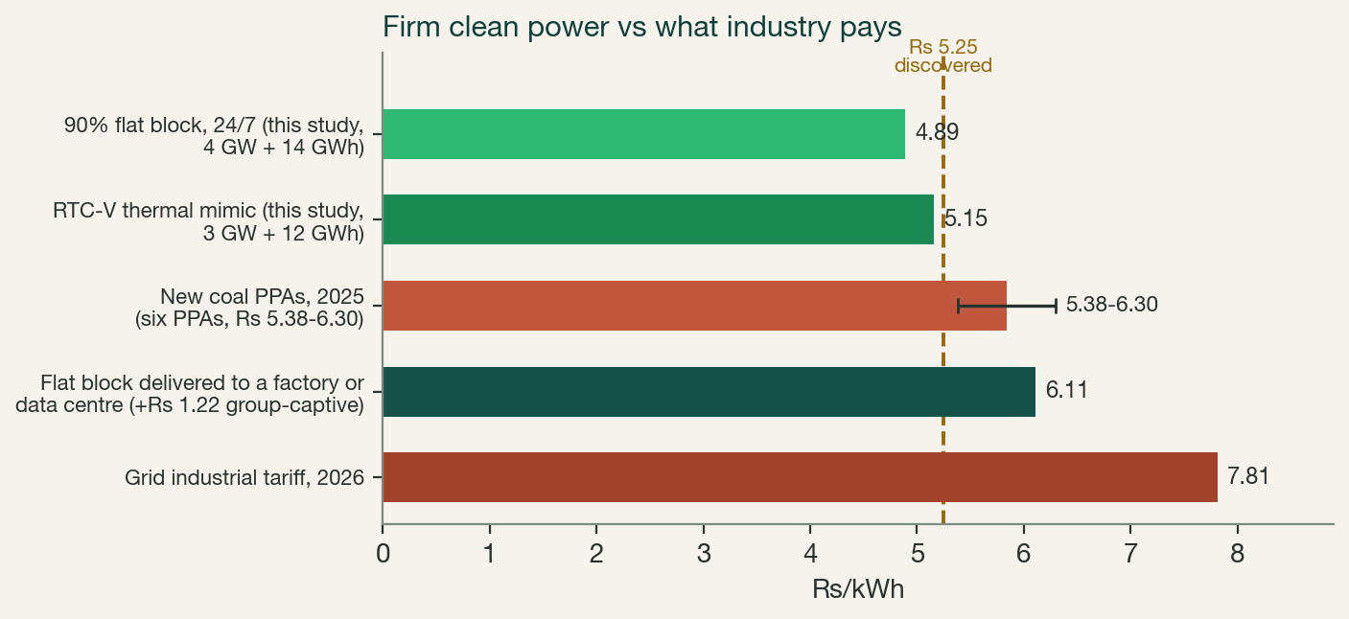
WHAT THIS UNLOCKS: INDUSTRY AND DATA CENTRES
AUGUST 2026
The same machine sells a 24/7 flat block at Rs 4.89
A 90% flat block monetizes the midday solar the tender caps at 60%; delivered through group-captive open access it undercuts the industrial grid tariff by a fifth
DATA CENTRES: THE FIRST BUYERS
●
Delivered at Rs 6.1-6.5, a fifth below the Rs 7.8 grid tariff: India's ~1.3 GW of data centres (4-5x by 2030) can wheel this block through group-captive open access; a 100 MW campus saves over Rs 100 crore a year. Lands inside IECC's own Rs 5.5-7.0 band for 24/7 clean DC power; US and EU firm-clean contracts run $100-150/MWh.
●
Hourly matching doubles: this profile delivers ~90% hourly carbon-free energy by construction; a vanilla solar PPA of the same annual volume scores ~44%.
GREEN STEEL: THE ASSUMPTION IS NOW A PRICE
●
Berkeley's green-steel case assumed a $55/MWh flat block; Rs 5.25 IS $55 at today's rupee. At 4 MWh per tonne (36% of steel cost), green H2-DRI beats blast-furnace steel into the EU from CBAM day one, and sits ~9% above it domestically, a gap coking-coal and rupee escalation close by ~2030.
GREEN HYDROGEN: THE ONE THAT NEEDS CHEAPER
Why the flat block is not dearer: the tender's 60% offtake cap throttles what the plant may bill at midday; a flat 90% floor sells that same capped solar at full tariff. Same contract structure (partial credit, 5% market energy, penalties inside): 4 GW + 14 GWh = Rs 4.89. Our earlier UC Berkeley study's stricter product (full 1 GW, binary hour scoring, no market energy) needs 5 GW + 16 GWh at Rs 5.08 plant-gate; this engine reproduces that too.
●
Rs 5.25 makes hydrogen ~$3.7/kg vs the $3 target: each Rs 1/kWh moves H2 by $0.60/kg. Electrolysers want the co-located, off-grid version of this same design at ~Rs 4.1/kWh, not a grid-delivered PPA.
Who switches on price alone: data centres, chlor-alkali, and every industrial buyer paying Rs 7.7-7.9 to the grid. Aluminium's Rs 3 captive coal waits for carbon pricing. The product now exists at a discovered price; open-access rules, not economics, set the pace.
UC Berkeley simulation (flat block: sim/run_flat90_sweep.py, Rajasthan, v4 basis, no spill revenue) and IECC, UC Berkeley analyses at iecc.gspp.berkeley.edu: Plummeting Solar+Storage Auction Prices (May 2025); Economic Case for Green Steel Production in India (May 2026); Clean Energy as Economic Statecraft, Strategy 5 (Feb 2026, data centres); Electrifying Industrial Heat in India (Apr 2026: grid tariff Rs 7.81, group-captive adder Rs 1.22); SAF report App. A.1 (Jun 2026, LCOH). Open access per GEOA Rules 2022; third-party route adds Rs 2.8-4.7 incl. cross-subsidy surcharge.
SECI FDRE-RTC-V analysis · solar + storage vs the Rs 5.25 result · 11 of 12
Paliwal · Phadke · Abhyankar · umed@berkeley.edu

